Slide 1
My SQL settings

Slide 2
Key Topics
Creating error Log_MySQL
Max_connections

Slide 3
There are 3 logs
Creating error Log_MySQL
Error Log
Query Log
Slow Query Log

Slide 4
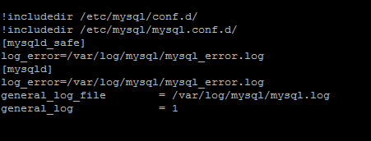
How to enable these Logs ?
Go to /etc/mysql/mysql.conf.d/mysqld_safe_syslog.cnf
Remove content from There… They are related to [mysqld_safe]
Go to /etc/mysql/my.cnf
Follow the steps from here:
https://stackoverflow.com/questions/5441972/how-to-see-log-files-in-mysql
Ignore Slow SQL error Log – Don’t keep blank – Below is working Snap

Slide 5
Max_connections
Too Many connections error : This will make our server go down.
Follow Steps from this :
https://www.electrictoolbox.com/update-max-connections-mysql/

Slide 6
Setting Max_connections
https://www.digitalocean.com/community/questions/max_connections-will-not-change-in-ubuntu
https://askubuntu.com/questions/892858/how-do-i-set-wait-timeout-to-unlimited-in-mysql

Slide 7
For restarting the mysql serever
sudo /etc/init.d/mysql start
sudo /etc/init.d/mysql stop
If it is failing with error : ERROR] Could not open file '/var/log/mysql/error.log' for error logging: Permission denied
https://support.plesk.com/hc/en-us/articles/115004039393-Unable-to-start-mysql-var-log-mysql-error-log-Permission-denied

